Slide 1
FRB Update #21
William Huang
(10/28/2020)

Slide 2
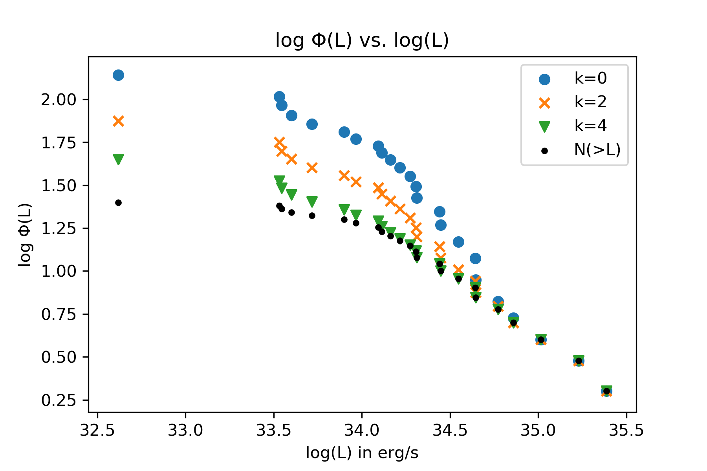
Phi vs. L: Fixed x-axis label

Slide 3
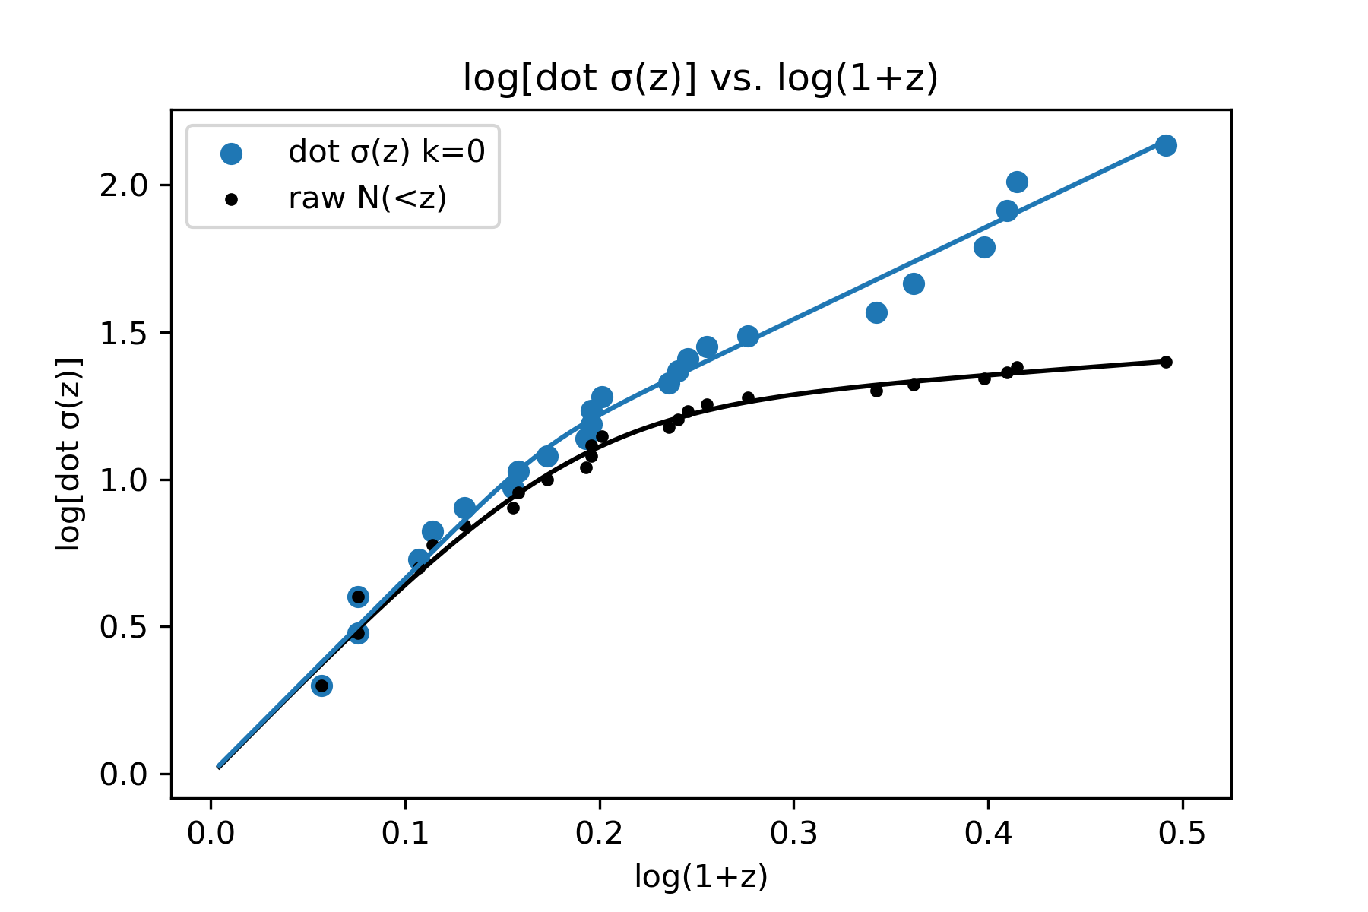
dot sigma (k=0) fit
For dot sigma (k=0):
[d1, d2, Z_c, n] = [6.63, 3.16, 1.48, 7.84]

Slide 4
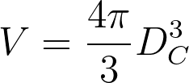
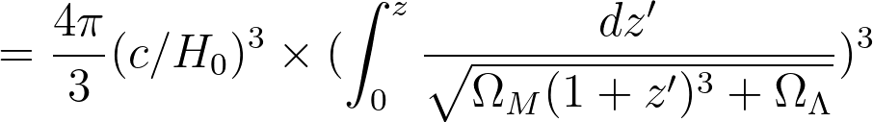
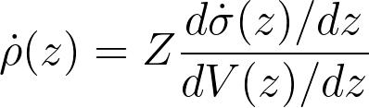
dot rho
I calculated dot rho using the following formulas, using the units of sigma for the numerator and units of Mpc^3 for the denominator. The graph of dot rho is on the following slide:

Slide 5
